Slide 1
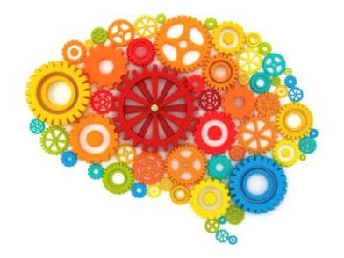
Dynamic Assessment Introductory session – Learning theories
Dr Klair Norman
Academic Programme Tutor (Y3) / EP Bournemouth Council

Slide 2

Aims
To revise, revisit and critically appraise theories of learning and intelligence
To have a basic theoretical grounding in key learning theories that take account of the environmental and socio-cultural aspects of intellectual development and to recognise how these inform Dynamic Assessment
To gain knowledge of the range of cognitive abilities that the learner brings to their learning.
To consider what current evidence tells us about learning and how this might influence the role and actions of an EP
Notes:
2

Slide 3

Test your knowledge…

Slide 4
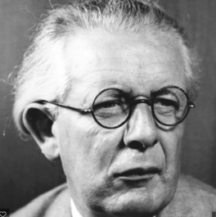
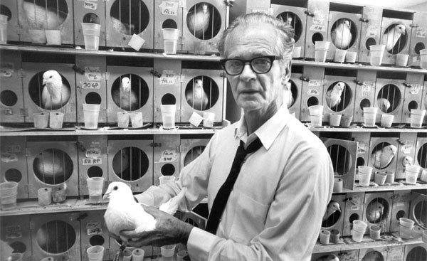
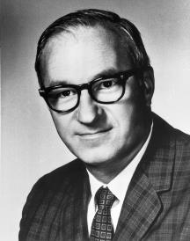


Slide 5
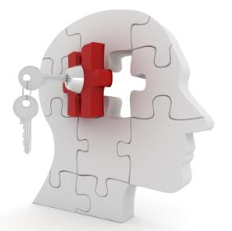
Theories of Learning:
Watson/Skinner
Piaget
Bandura
Notes:
5

Slide 6
Theories of Learning:
Watson/Skinner
Operant conditioning and ‘Law of Effect’
Informs sanction and reward systems of many modern schools
Tends to overlook the importance of intrinsic motivation and some evidence suggests rewards and praise can be deleterious
Notes:
6

Slide 7
Theories of Learning:
Piaget
Assimilation and accommodation. Baseline assessments to inform learning.
Developmental stage theory (sensorimotor, preoperational, concrete, formal) and assessments of cognitive capacities.
Underestimates children’s abilities and overlooks cultural effects
Notes:
7

Slide 8
Theories of Learning:
Bandura
Social learning theory
The importance of observational learning, modelling and reciprocal determinism
Ignores physiological states and learning differences
Notes:
8

Slide 9
Theories of Learning:
Dynamic Assessment

Slide 10
Theories of Learning:
Dynamic Assessment
Vygotsky
Luria
Feuerstein

Slide 11
Vygotsky
Intellectual development results from interplay between spontaneous natural development and the social interaction of children with adults and peers
The concept of PSYCHOLOGICAL TOOLS
The role of MEDIATION in the development of intellectual functioning
The role of social adaptation through interaction with MORE COMPETENT OTHERS
The Zone of Proximal Development (ZPD)

Slide 12
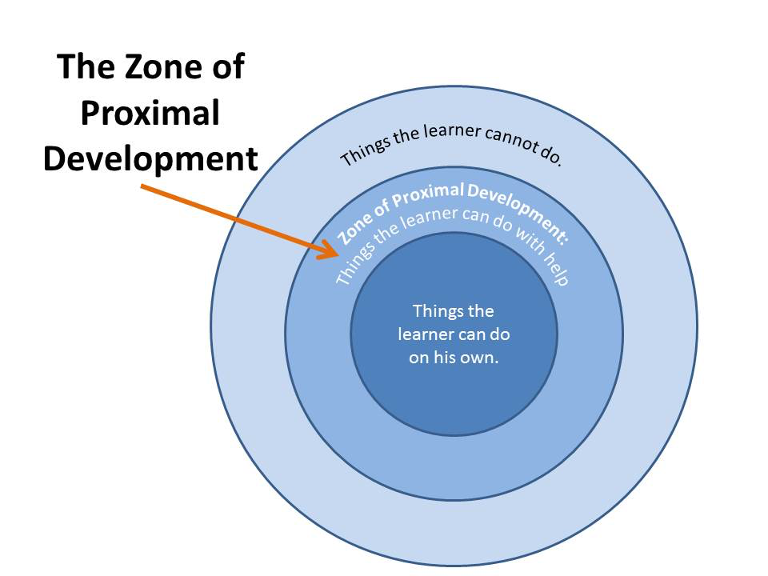
Vygotsky
Intellectual development results from interplay between spontaneous natural development and the social interaction of children with adults and peers
The distance between a child’s “actual development level as determined by independent problem solving” and the higher level of “potential development as determined through problem solving with adult guidance or in collaboration with more capable peers”
Vygotsky, 1978 p.86

Slide 13
Vygotsky
Intellectual development results from interplay between spontaneous natural development and the social interaction of children with adults and peers
The exterior position of mediators is necessary to ascertain what learners need to know at any given stage and to help advance the learners at a pace suitable to their capabilities (challenging but not frustrating them)
To help learners, mediators need to use metacognitive strategies so they can organise, integrate, apply and generalise new knowledge and skills

Slide 14
Luria
Complex psychological processes have systemic structure. Each form of conscious activity represents a complex functional system and takes place through the concerted working of three brain units
Three principal FUNCTIONAL UNITS of the brain necessary for human mental processes
The role of FEEDBACK and SPECIFICITY in the development of intellectual functioning
The bottom up development of the brain (where defects of the lower zones affect development of higher zones)

Slide 15
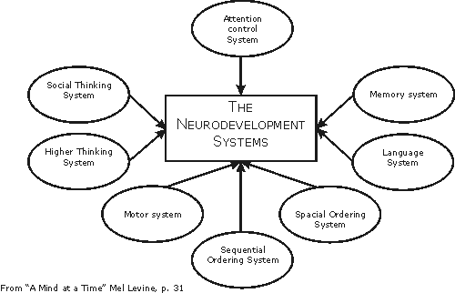
Luria
Influenced NEURODEVELOPMENTAL theories

Slide 16
Theories of Intelligence:
Spearman
Gardner
Sternberg
Notes:
Spearman - general intelligence
Gardner – multiple intelligences
Sternberg – triarchic theory – analytical, creative, practical
16

Slide 17
Feuerstein
Intelligence is “not fixed but rather modifiable”
According to Feuerstein, intelligence “is the direct result of mediated learning experience (MLE), whereby a child’s cognitive abilities are developed unconsciously through the cultural stimuli passed on by his or her parents and grandparents. In cases where the cultural pattern has been broken, the child fails to develop cognitive skills and may well be (falsely) categorised as having learning difficulties”
Sharron, 1987 “Changing Children’s Minds”

Slide 18

Feuerstein
Intelligence is “not fixed but rather modifiable”
Introduced the MEDIATED LEARNING EXPERIENCE (MLE) and INSTRUMENTAL ENRICHMENT
The role of the MLE as the crucial ingredient that determines STRUCTURAL COGNITIVE MODIFIABILITY
DISTAL and PROXIMAL determinants of intellectual development
Notes:
Stimulus – response / Stimulus – organism – response / H = mediator

Slide 19
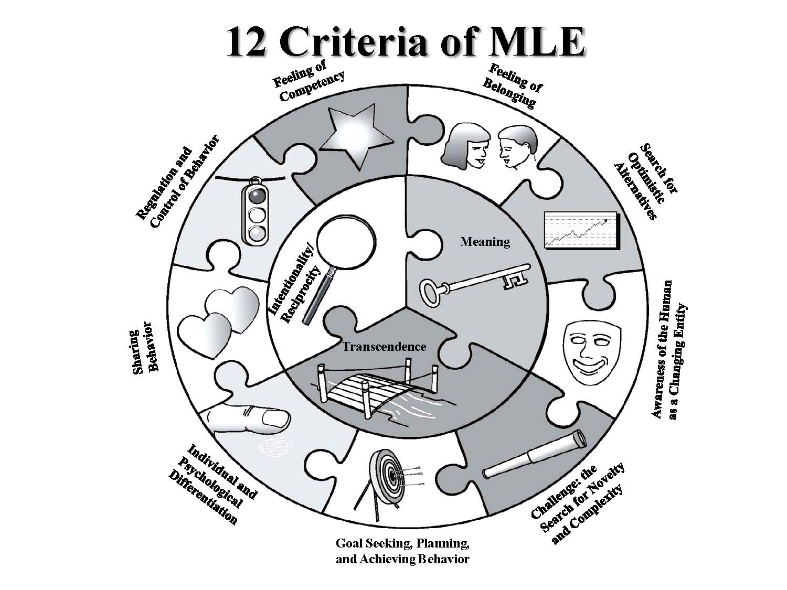
Feuerstein
Intelligence is “not fixed but rather modifiable”

Slide 20
Feuerstein
Task
A Tripartite Learning Partnership Model
Student brings cognitive abilities to the task / Task requires cognitive processes from student
Mediator analyses task / Task determines mediation
Mediator analyses student’s cognitive abilities / Student requires support from mediator
Mediator
Student

Slide 21

Dynamic Assessment
Questions in psychological assessment are now less concerned with issues as to how to classify and sort children and instead are able to focus on how to best teach the individual child.
Dynamic assessment (DA) is grounded in the belief that we learn from about a children’s cognitive development by working WITH them as opposed to assessing their unassisted performance
DA fulfils a different purpose to static assessment,
in that it can empower the child and he/she is
able to play a more active role in the assessment and intervention process

Slide 22
Dynamic Assessment
“If we wish to determine how far the child’s knowledge base deviates from the norm, we will continue to administer a [norm-referenced] measure. If we wish to determine the content of the child’s knowledge base within a specific domain, we will administer a curriculum-based or criterion-referenced test. If we wish to derive hypotheses about how the child learns, how responsive the child is to attempts to intervene, and what seems to be interfering with the child’s ability to profit from existing attempts at instruction, we will use dynamic assessment.”
Lidz, 1991 p.121-122

Slide 23

Curriculum-based Dynamic Assessment
Interactive assessment
Clinical Dynamic
Assessment
Structural Dynamic Assessment
Dynamic Assessment
Research Dynamic
Assessment
Dynamic
Testing
Functional Dynamic Assessment
Learning Potential assessment

Slide 24

Russia / Northern Europe
Vygotsky
Guthke – Learning Potential/ Dynamic testing
USA
Haywood / Lidz – Interactive assessment
Sternberg/ Grigorenko
Tzuriel
Southern Europe/ Israel
Piaget/ Rey
Feuerstein Dynamic assessment
Tzuriel
Origins of different formats of DA
Notes:
Early 20th century Europe – dominated by psychoanalysis, behaviourism, psychometrics

Slide 25
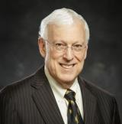
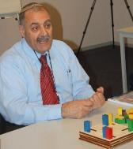



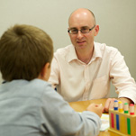
Dynamic Assessment
Robert Sternberg
David Tzuriel
Carol Lidz
Ruth Deutsch
Elena Grigorenko
Fraser Lauchlan

Slide 26

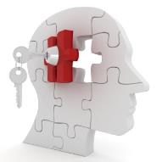
Cognitive abilities of a learner:
Notes:
26

Slide 27
Deficient Cognitive Functions (Tzuriel)
INPUT PHASE
Blurred and sweeping perception
Impulsive, unsystematic exploratory behaviour
Receptive verbal tools
Spatial orientation
Temporal constructs
Conservation of constancies
Need for precision and accuracy
Simultaneous consideration of two or more pieces of information
ELABORATION PHASE 1
Perception of the existence of a problem
Selecting relevant cues for defining a problem
Spontaneous comparative behaviour
Narrowed mental field
Episodic grasp of reality
Need for pursuing logical evidence
ELABORATION PHASE 2
Internalisation of a learned concept or strategy
Inferential – hypothetical testing
Strategies for hypothesis testing
Define the framework necessary for a solution
Summative behaviour
Planning behaviour
Non-elaboration of cognitive categories
OUTPUT PHASE
Egocentric communication modality
Projecting virtual relationships
Trial and error responses
Verbal tools for communication
Need for precision and accuracy
Visual transport
Acting-out behaviour
Notes:
27

Slide 28
Lauchlan and Carrigan (2013):
Cognitive Learning Principles | Affective Learning Principles
Communication | Accessibility to Assistance
Comparative Behaviour | Attention
Efficiency | Concentration
Exploratory Behaviour | Confidence in Correct Response
Justification of Response | Flexible Thinking
Memory | Frustration Tolerance
Nature of Response | Motivation
Planning | Presentation
Problem Definition | Task Perseverance
Recognition | Vitality and Awareness
Reflectiveness
Spatial Orientation
Transfer of Learning
Vocabulary
Notes:
Working Memory
Baddeley (1992) – Components
28

Slide 29
The Cognitive Abilities Profile (CAP)
Attention
Perception
Memory
Language and Communication
Reasoning/Logic
Strategic Thinking/Metacognition
Behaviours Affecting Learning
(Openness to intervention of Adults / Peers; Self-regulation of emotions and overcoming blocking; Self-regulation of movement;
Motivation; Curiosity; Response to challenge; Persistence
and task completion).
Notes:
29

Slide 30
Cognitive Abilities
“In Britain, there is a great deal of rhetoric about the need for cognitive skills, along with, in my view, a complete lack of appropriate intellectual or financial commitment”
Sharron, 1987 “Changing Children’s Minds”
Notes:
30

Slide 31

Theories of Intelligence:
“The most useful item developed by psychological science is the concept of intelligence. For more than a century this sturdy understanding has been tweaked from pure g to multiples, from fixed to malleable, admired and despised. Although around the world it may be differently interpreted, there is a basic understanding that individual intelligence is to do with the ability to deal with one’s world. Measures of intelligence are reliable and regularly improved to serve their purpose of predicting intellectual achievement, mostly in school. Its an infinitely more valuable tool than a non-stick pan”
Professor Joan Freeman. The Psychologist. October 2015
Notes:
Spearman general intelligence
Gardner – multiple intelligences
Sternberg – triarchic theory – analytical, creative, practical
31

Slide 32
Theories of Intelligence:
“Intelligence has been an important and controversial topic throughout psychology's history. Despite the substantial interest in the subject, there is still considerable disagreement about what exactly constitutes intelligence. In addition to questions of exactly how to define intelligence, the debate continues today about whether accurate measurements are even possible.”
about.com
Notes:
Spearman general intelligence
Gardner – multiple intelligences
Sternberg – triarchic theory – analytical, creative, practical
32

Slide 33

Historical, Political Cultural Influences:
Children have moved from being ‘economically useful’ to being ‘economically useless’ but ‘emotionally priceless’ (Zelizer, 1994)
Children learning in the 21st century have exposure to opportunities, experiences and information previously unimaginable (Gray and Macblain, 2015)
Concerns over large corporations having influence over what type of learning takes place in schools (Illich, cited in Macblain, 2014).
The education system is grossly inadequate; leading us to increasing incompetence through contributing to and supporting a system that expects humans to engage in endless and senseless work to either consume abundant resources or create products (and by-products) that inflict endless damage in their production or disposal, thus heading us to our own extinction. (Raven, 2014)

Slide 34
From theories to evidence:
Interleaving
Spaced learning
The testing effect
Notes:
34

Slide 35
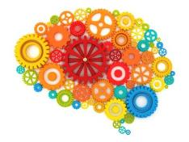
Summary:
No single theorist offers a complete explanation of children’s learning and each have their strengths and weaknesses
Cultural, political and historical factors can affect learning (which is seen as a dynamic and evolving set of expectations, opportunities and processes)
What we normally expect of children and young people and how we assess and support them with their learning can be affected by underpinning theories and beliefs about intelligence, development and utility of certain knowledge/skills (as well as cultural and political influences)
Notes:
35

Slide 36

Questions?

